Slide 1
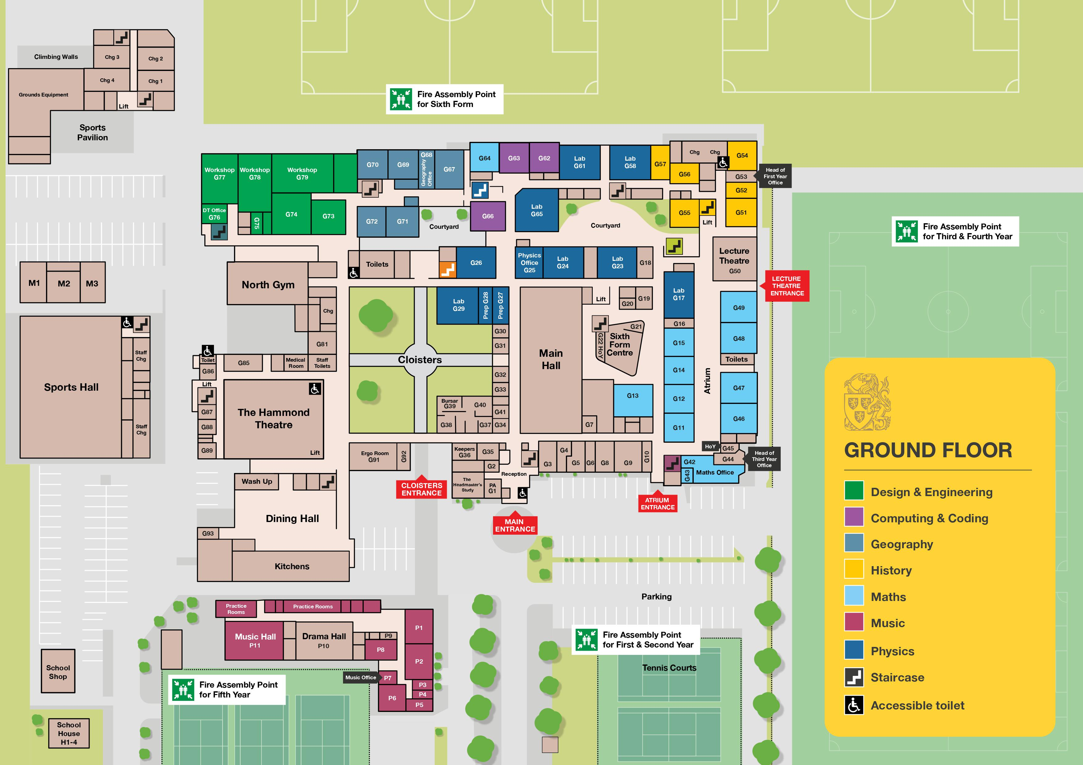









Slide 2
Progress
G5: 1 2 3 4 5 6 7
Lifts: Yellow

